Slide 1
JIRA

Slide 2
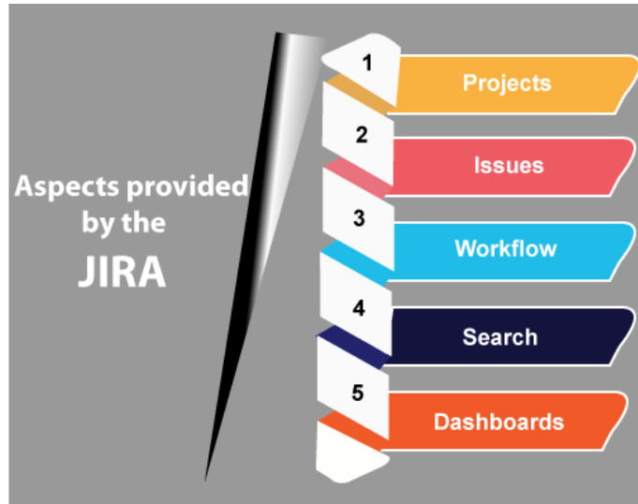
What is jira
JIRA is a software testing tool developed by the Australian Company Atlassian. It is a bug tracking tool that reports all the issues related to your software or mobile apps.

Slide 3
Advantages of using jira
Plan, Track and Work Faster
The main source of information
Organize the documentation tasks
Track the progress of our documentation
Helps to meet the deadlines of a documentation release.
Measures the time spent on documentation
Provides feedback faster

Slide 4
What is scrum
Scrum is an agile framework that helps you to organize, iterate, and continue the same project that you are working on. In scrum, a product is built in the series of iterations known as sprints or parts.
Sprint: Sprint is a time-boxed period in which the scrum team needs to finish the set amount of work. Each sprint has a specified timeline, i.e., 2 weeks to 1 month. The scrum team agrees with this timeline during the sprint planning meeting.
Scrum Master: Scrum Master is defined as a facilitator or servant-leader to the Scrum development team. Scrum Master must ensure that scrum principles are followed.
Scrum development team: A scrum development team is a collection of individual members that includes developers, QA, and scrum master. It decides and provides the effort estimate. The recommended size of the scrum team is between 5 and 9 members.

Slide 5
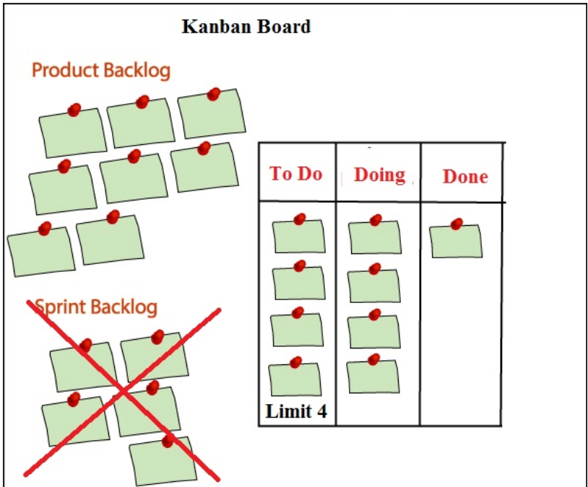
What is kanban
Kanban is the most popular agile framework after Scrum for software development. It provides the real-time and transparency of work. In Kanban board, all the tasks are visible that allows the team members to see the state of every task at any time.

Slide 6
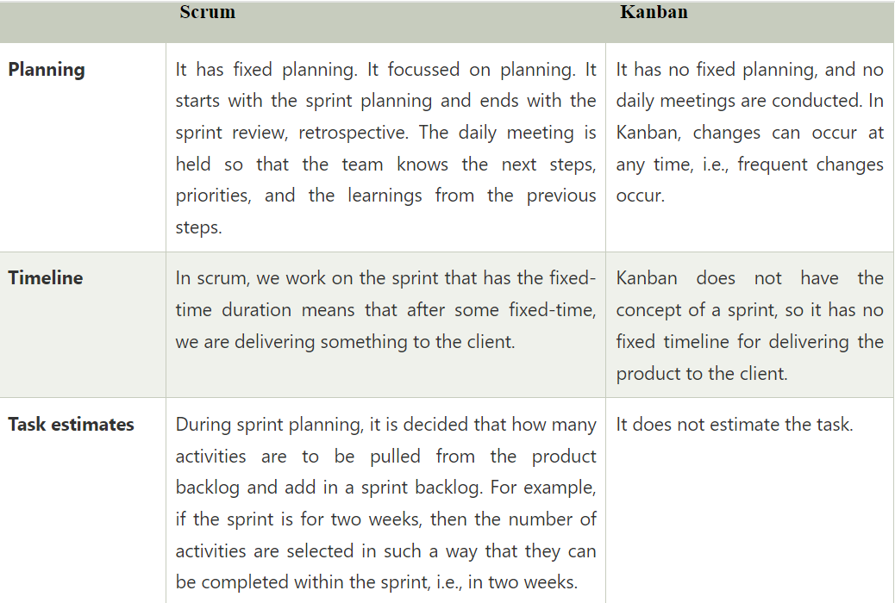
Kanban vs scrum

Slide 7
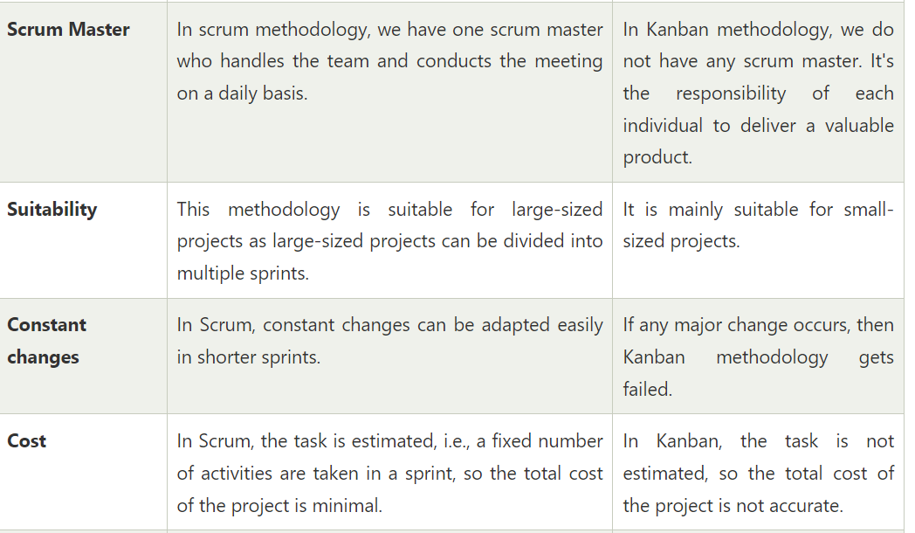
Kanban vs scrum

Slide 8
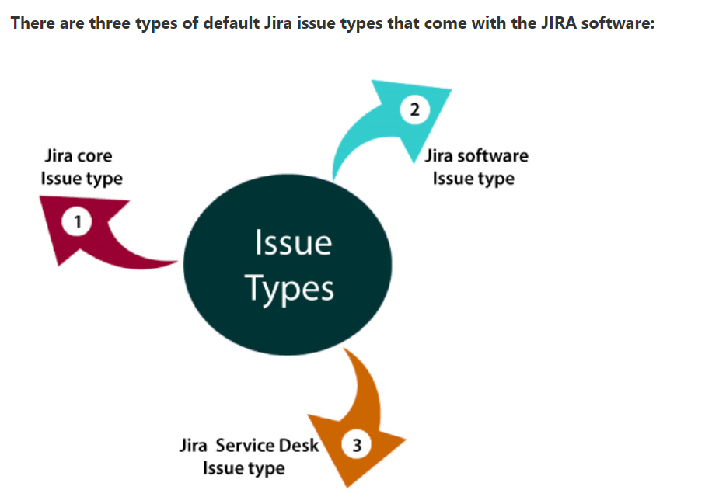
Jira issues type
JIRA application can be used to break the pieces of work into issues. Issues can be represented as tasks, subtasks, bug, epic, feature requests, or other pieces of work. Each Jira software comes with some default issue types that suit your projects and teams.

Slide 9
Jira issue types
Jira Core (business projects) issue types
Jira Software (software projects) issue types
Jira Service desk (service desk projects) issue types.

Slide 10
Jira core issue types
Task The task is the work which is to be completed or done to achieve the team's goal.
Subtask It is the subtask of an issue. All the tasks that come under the logged issue are known as subtasks.

Slide 11
Jira software issue type
Bug
A bug is the problem or defect that occurs in the functions of a product.
Epic
Epic is a large user story which is to be broken into smaller stories
It cannot be achieved in a single sprint.
The whole epic is completed in months.
Epic refers to a set of activities which are not converted into user stories yet.
First, Epics are converted into user stories, and then user stories are converted into several tasks on which agile team work.
Epics are broad in scope and lacking details, and they split into smaller and multiple stories on which agile team work on.
Epic is referred to as a 'top-tier in the work hierarchy.

Slide 12
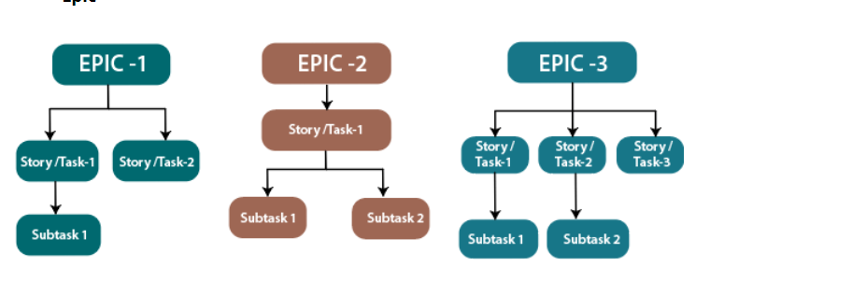
Jira epics

Slide 13
Story in jira
The story is a list of tasks that need to be completed within a project.
It defines the high-level design of project requirements.
It defines the short and simple descriptions of the whole project.
It is owned by the product owner of a company, but anyone can write the user story.
It is written in simple language so that customers can understand the final product.
User stories can be considered as the "heart of scum" as it serves as the building blocks for the sprint.

